Slide 2
Fault Driven Development
BRK1108
Josh Garverick

Slide 3
Agenda
Context
What is a Fault?
What is an Exception?
What is FDD?
Patterns and Practices
Proactive (fault tolerance)
Reactive (fault handling)

Slide 4
What is a Fault?
In document ISO 10303-226, a fault is defined as an abnormal condition or defect at the component, equipment, or sub-system level which may lead to a failure. (Wikipedia)

Slide 5
What is an Exception?
Exception handling is the process of responding to the occurrence, during computation, of exceptions – anomalous or exceptional conditions requiring special processing – often changing the normal flow of program execution. (Wikipedia)

Slide 6
What is Fault Driven Development?
A methodology for developing solutions that expect and gracefully handle software, platform, and architectural faults
Telemetry
Error handling
Application
Platform
Non-functional requirements
Eventual vs. immediate consistency
Availability, resiliency, scalability, recoverability
!(Blaming others) && !(Plate Tectonics)

Slide 7
Azure Patterns and Practices
Performance / Scalability
Resiliency
Cache-aside
CQRS
Event Sourcing
Index Table
Materialized View
Priority Queue
Queue-based Load Leveling
Sharding
Static Content Hosting
Throttling
Bulkhead
Circuit Breaker
Compensating Transaction
Health Endpoint Monitoring
Leader Election
Queue-based Load Leveling
Retry
Scheduler Agent Supervisor
Notes:
Show this slide quickly to get an overall message of “there’s a lot of these”, then skip to the next slide

Slide 8
Common Patterns
Performance and Scalability
Command Query Responsibility Segregation (CQRS)
Static Content Hosting (CDN)
Resiliency
Retry
Health Endpoint Monitoring
Notes:
CQRS: Commonly implemented with RESTful APIs for reporting and asynchronous messaging for commands (adding or altering data). Examples include NServiceBus.
Static Content: Allows static files (images, HTML, CSS, JS) to leverage global distribution networks for faster localized loading; Azure CDN + Storage Account
Retry: setting thresholds for retrying delivery of a message to ensure processing. Linear or back-off retries are common. Polly.NET and NServiceBus are examples.
Health Endpoint Monitoring: setting listeners to poll endpoints (PING, IFUP); ILB, AGW, IIS have concepts of “site” health pings. Services can implement health checks through custom routes or Swagger, if applicable.
In both resiliency cases, alerts and notifications are required to ensure any potential issues are surfaced to responsible individuals.

Slide 9
Demo
Finding and Implementing Common Patterns
Notes:
We’re going to cover the basics by going to the Azure interactive site for a walkthrough.

Slide 10
Proactive Approach: Fault Tolerance
Discover
Areas prone to errors
Mission critical functionality
Single points of failure
Expect
API calls, methods, processes to fail
Service outages
Plan
Business Continuity
Disaster Recovery
Notes:
It’s important to determine what areas of the application you’re working on have been prone to errors in the past.
If working with a greenfield application, stress testing can help flush out problematic areas.
Mission critical portions of the application (or maybe the entire application) require protection and planning to make sure users are not impacted by outages.
Any part or component that is required for the application to run can potentially be a SPOF--good candidates for resiliency reinforcement.

Slide 11
Reactive Approach: Fault Handling
Capture
Exception handling (try/catch/throw)
Graceful degradation
Notify
Alerts
Notifications
Study
Post-mortems
Feedback incorporation
Notes:
What happens when:
a software exception is not handled?
an infrastructure fault is not handled?
How are faults/exceptions raised as issues? Who gets notified? Is there alert clutter? Is there an incident response plan?
How difficult or time consuming is it to perform a root cause analysis on an exception or fault? Taking the information from a post-mortem and taking action is essential.

Slide 12
Demo
Pulling it all Together
Notes:
We’ve talked through the preliminary components for proactive fault tolerance as well as fault and exception handling on the application side.
Now let’s put the components together, deploy some things, and run some tests.

Slide 13
Resources
Microsoft Azure Availability Checklist
Microsoft Azure Cloud Design Patterns
Patterns for Fault Tolerant Software (R. Hanmer)
Cloud Computing Patterns: Fundamentals to Design, Build, and Manage Cloud Applications (C. Fehling et al.)
Azure Architecture Center
Azure Interactives

Slide 14
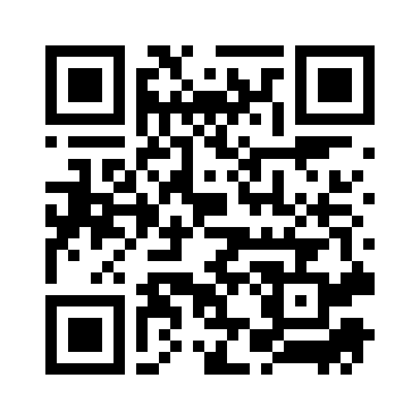
Please evaluate this session Your feedback is important to us!
This slide is required. Do NOT delete or alter the slide.
The slide will be replaced onsite through Silver Fox Productions with an updated QR code.
From your PC or Tablet visit MyIgnite at http://myignite.microsoft.com
From your phone download and use the Ignite Mobile App by scanning the QR code above or visiting https://aka.ms/ignite.mobileapp

Slide 15

Thank you for your time! Any questions?
@jgarverick
joshgarverick.blogspot.com

